Slide 1




Music recommendation system
Sukesh-IN30189 Sudha Rani-IN30148 Ramesh-IN30124
Jayasree-IN30053 Mohan Siva Sai-IN30137

Slide 2


APPROACH:
DATA PREPARATION
POPULARITY BASED
COLLABORATIVE BASED
CONTENT BASED

Slide 3
DATA PREPARATION:
Data preparation is the process of cleaning and transforming raw data prior to processing and analysis. It is an important step prior to processing and often involves reformatting data, making corrections to data and the combining of data sets to enrich data.
Data preparation is often a lengthy undertaking for data professionals or business users, but it is essential as a prerequisite to put data in context in order to turn it into insights and eliminate bias resulting from poor data quality.
For example, the data preparation process usually includes standardizing data formats, enriching source data, and/or removing outliers.

Slide 4
POPULARITY BASSED:
Popularity based recommendation system As the name suggests Popularity based recommendation system works with the trend. It basically uses the items which are in trend right now. For example, if any product which is usually bought by every new user then there are chances that it may suggest that item to the user who just signed up.
It is a subclass of information filtering system that seeks to predict the "rating" or "preference" a user would give to an item.
It is the most basic and simple algorithm. We find the popularity of each song by looking into the training set and calculating the number of users who had listened to this song. Songs are then sorted in the descending order of their popularity. For each user, we recommend top most popular songs except those already in his profile.

Slide 5
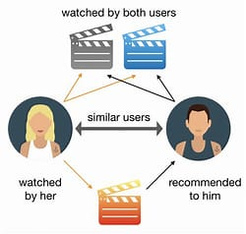
COLLABORATIVE FILTERING:
Collaborative filtering methods build a model based on users past behavior (items previously purchased, movies viewed and rated, etc) and use decisions made by current and other users. This model is then used to predict items (or ratings for items) that the user may be interested in.
To address some of the limitations of content-based filtering,
collaborative filtering uses similarities between users and items
simultaneously to provide recommendations. This allows for
serendipitous recommendations; that is, collaborative filtering
models can recommend an item to user A based on the interests
of a similar user B.

Slide 6
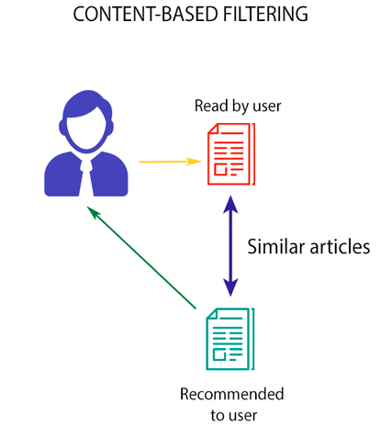
CONTENT BASED FILTERING:
Content-based filtering methods are based on a description of the item and a profile of the user’s preferences. These methods are best suited to situations where there is known data on an item (name, location, description, etc.), but not on the user. Content-based recommenders treat recommendation as a user-specific classification problem and learn a classifier for the user’s
likes and dislikes based on product features.
A content based recommender works with data that the user
provides, either explicitly (rating) or implicitly
(clicking on a Link).

Slide 7
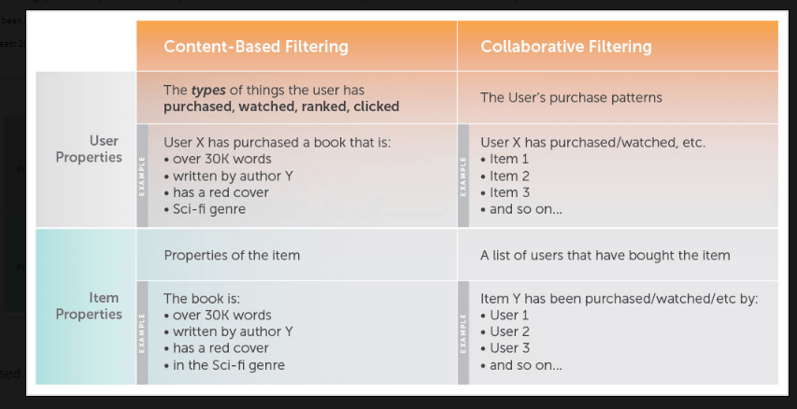

Slide 8
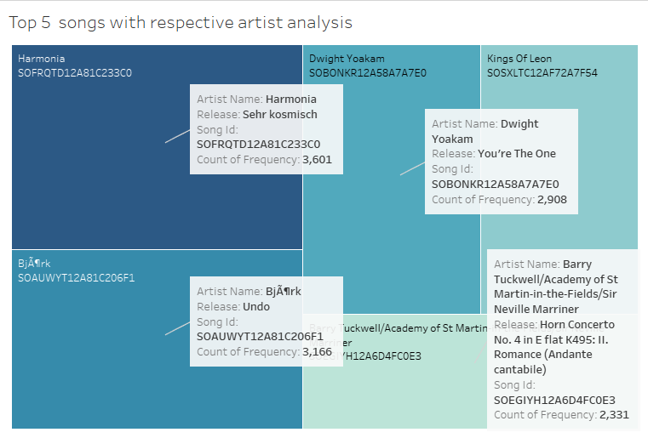
ANALYSIS USING TABLEAU:

Slide 9
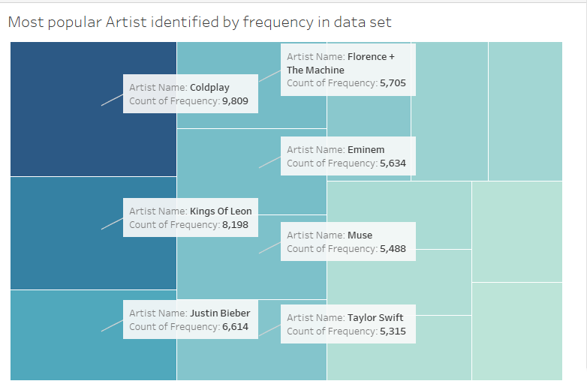
MOST POPULAR ARTIST:

Slide 10
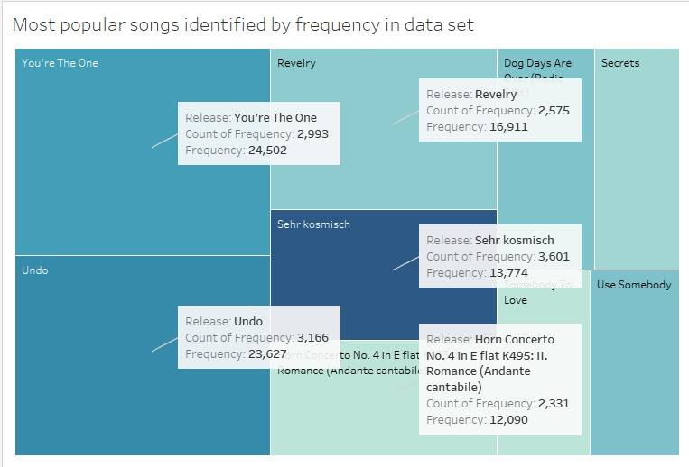

Slide 11

..THANKING YOU..

